Slide 1
Angular Component Communication
Communicating with a Child Component
Lecture 3
By James(Jin) Wang
12/27/2021

Slide 2
Outline
Child Component
Parent to Child Communication
Input Property
Watching for Changes
Template Reference Variable
ViewChild Decorator

Slide 3
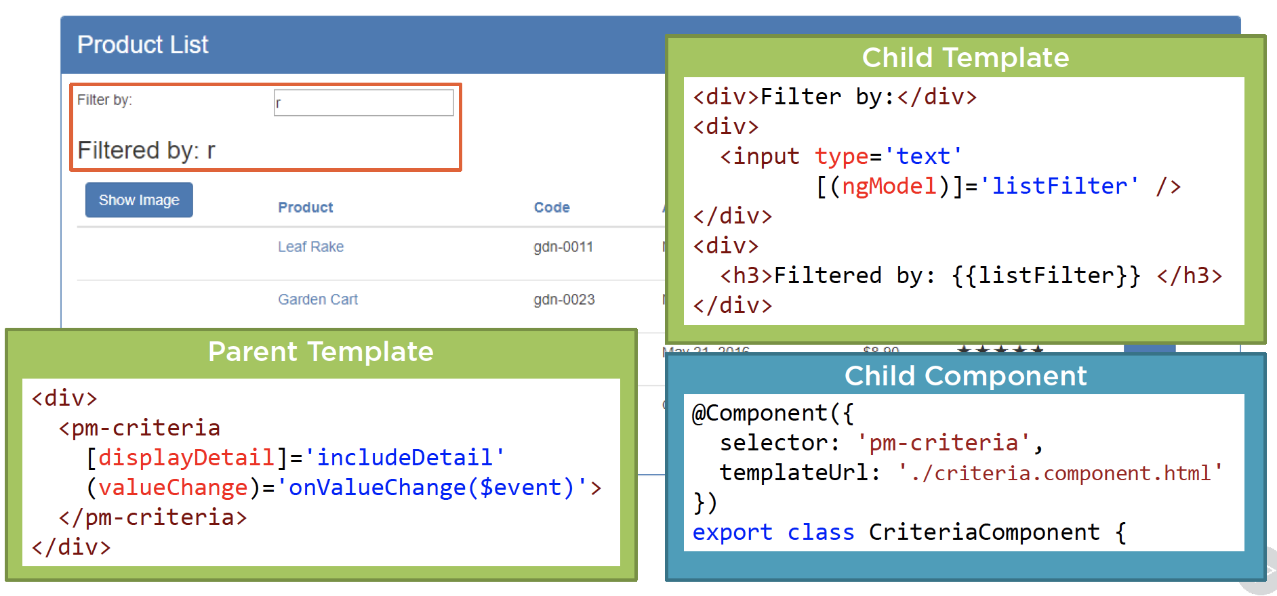
Child Component
  Building Child Components
  Demo: build a Child Component

Slide 4
ViewChild
  ViewChild
  Demo: viewChild

Slide 5
Summary

Slide 6
Assignment

Slide 7
Self Study
  Angular Component Communication
  https://app.pluralsight.com/library/courses/angular-component-communication

